Slide 1


Dungeons & Dragons Game State Manager
User Manual Developed for Retro Rabbit by Optimize Prime

Slide 2
Description
The application is intended to act as a helper and assistant when users are playing a game of Dungeons & Dragons. The application tracks information and events of the current game session being played, to provide players with an easier way to see the current state of the game, compared to keeping track manually on paper. It will provide users with an easier way to keep track of their current characters, as well as creating new characters or updating information on existing characters. Users will also have the ability to look at a monster journal, which shows all monsters that have been encountered so far, and allows users to add monsters that they encounter later. Users will be able to create accounts on the application where all of above mentioned information will be displayed. Users will be able to use the application either as a Dungeon Master or a normal Adventurer. A user playing as a Dungeon Master will be able to create a session, granting the session a name, password, and a limit on the amount of characters that can be in the session. A Dungeon Master will be able to set and trigger events such as setting a trap, and when an Adventurer walks over it, it triggers an event causing the Adventurer and/or their party to be notified of the event. A user playing as an Adventurer will be to join a session, if the user is nearby the session host (Dungeon Master).

Slide 3
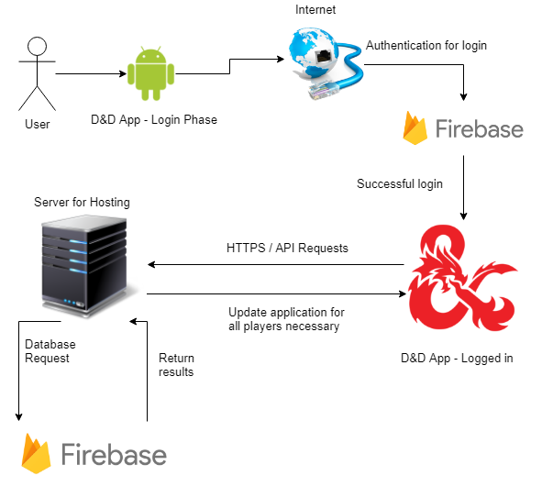
System Configuration
The picture here is to give you a brief overview of how the system works from logging you in, to how it handles requests to the server and the database for updating the state of the game.

Slide 4
Installation:
The steps for the current installation process are as follows:
Go to the following link: https://github.com/COS301-OptimizePrime/COS301-DnD/releases/download/v0.5-beta/DnD.GSM.apk
Download the APK
Copy it to your android device
Enable installations from untrusted sources on your device
Navigate to the APK via the file manager and install it.

Slide 5
Getting Started:
Using the application is very straight forward. When you open the application, you will be presented with 2 input fields for an email and a password, as well as 3 buttons: one to login with the details you have provided, one to sign in with a Google account, and one to register an account. The Google sign in option will open a list of Google accounts that are stored on your phone, and you simply have to choose one and enter your credentials in the steps that follow. To register an account, simply input a valid email address, and a password that is 6 characters or longer. Once you are signed in, it will take you to the Monster Journal viewer. To sign out at any time, simply press the “Sign Out” button in the top right hand corner of the application. To exit the application, simply close the application on your android device.
See the next page for screenshots

Slide 6
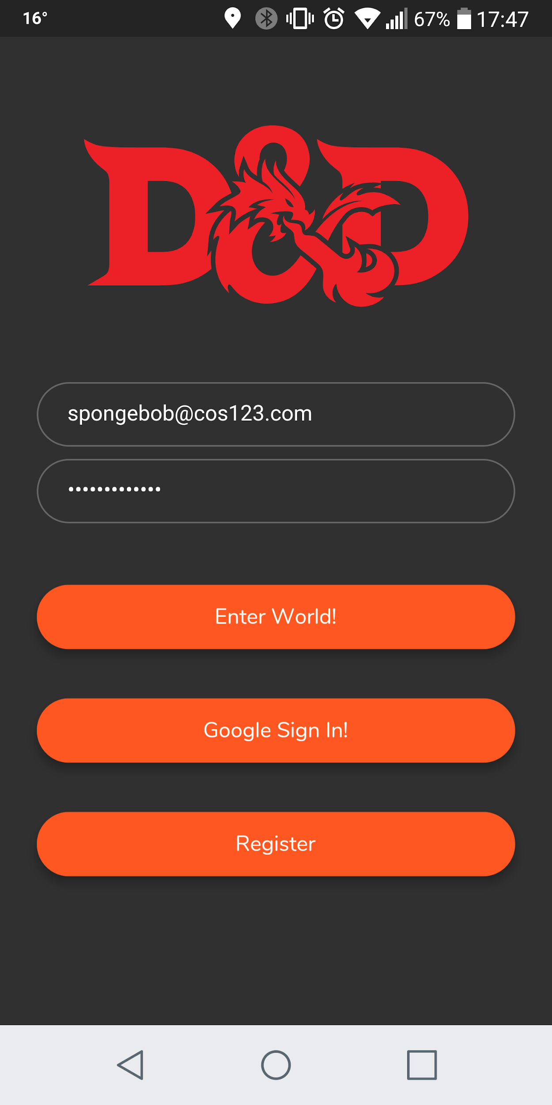
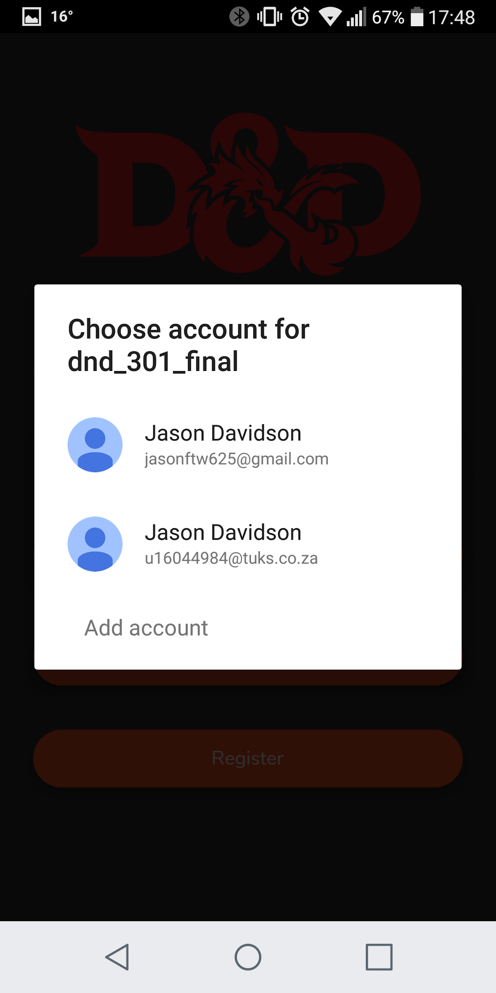
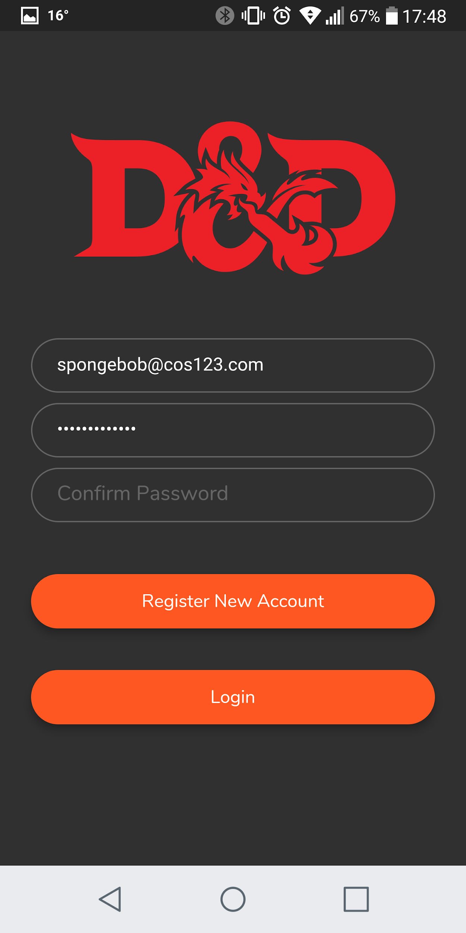
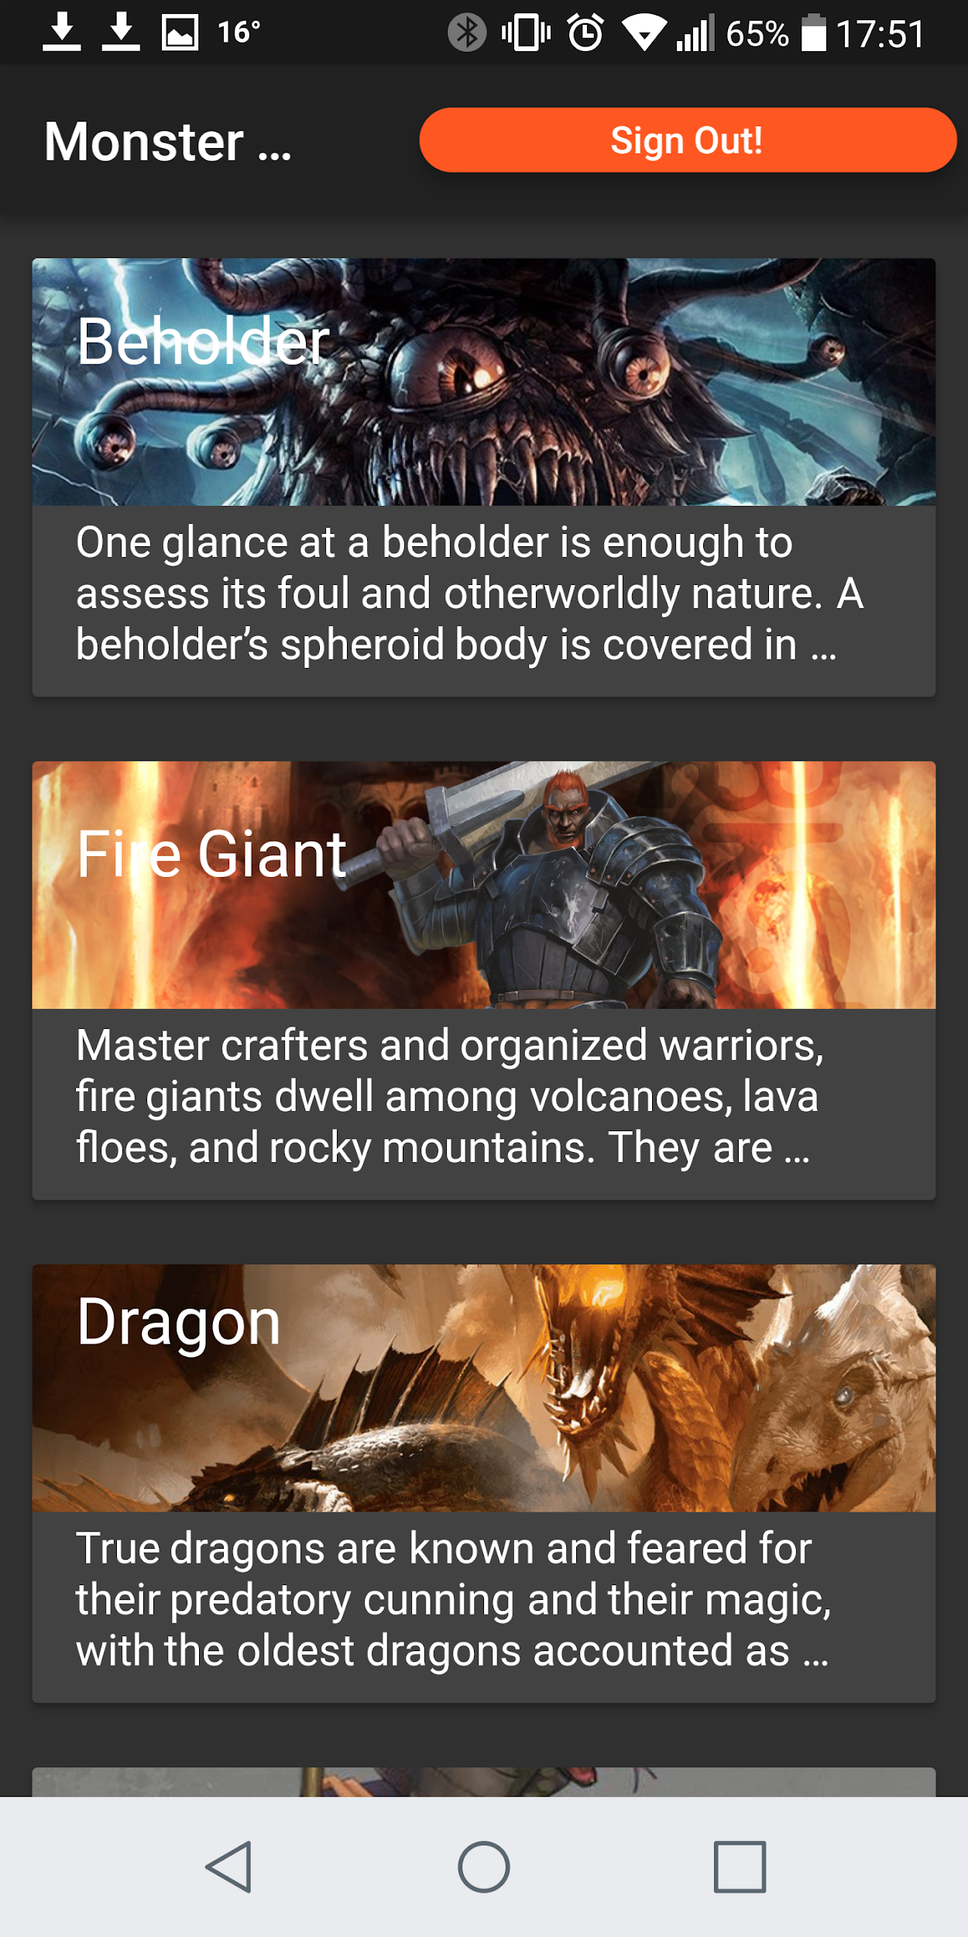

Slide 7
Using the system:
On the left side off the application, you will see the button for the navigation drawer. By clicking on it and expanding the drawer, you will be presented with a list of choices, some of which include: Home Page, Monster Journal, Race Viewer, Character Creation. By clicking on one of these, it will take you to the respective screen. On the Monster Journal page, you will be able to view all of the currently encountered monsters, and by clicking on the name of the monster, you will be able to see all of their stats, such as combat rating, hit points, alignment, etc.

Slide 8
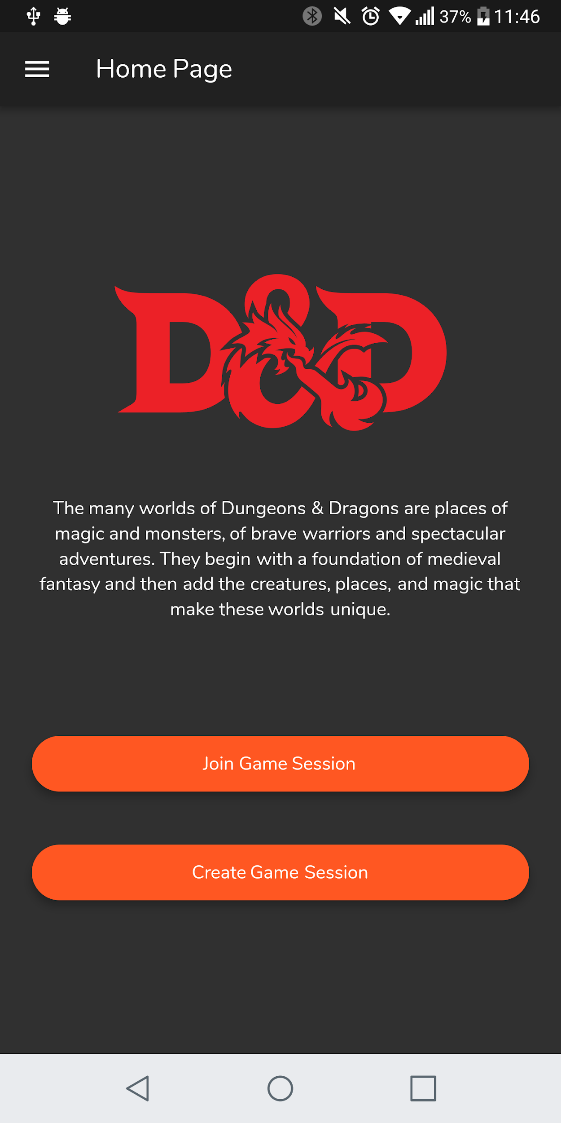
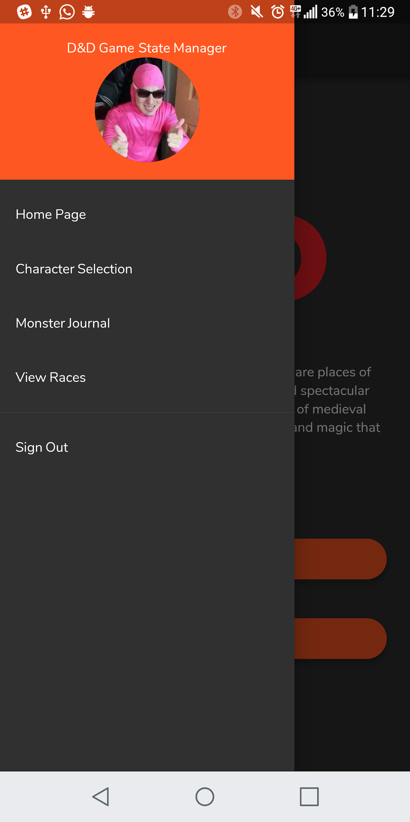

Slide 9
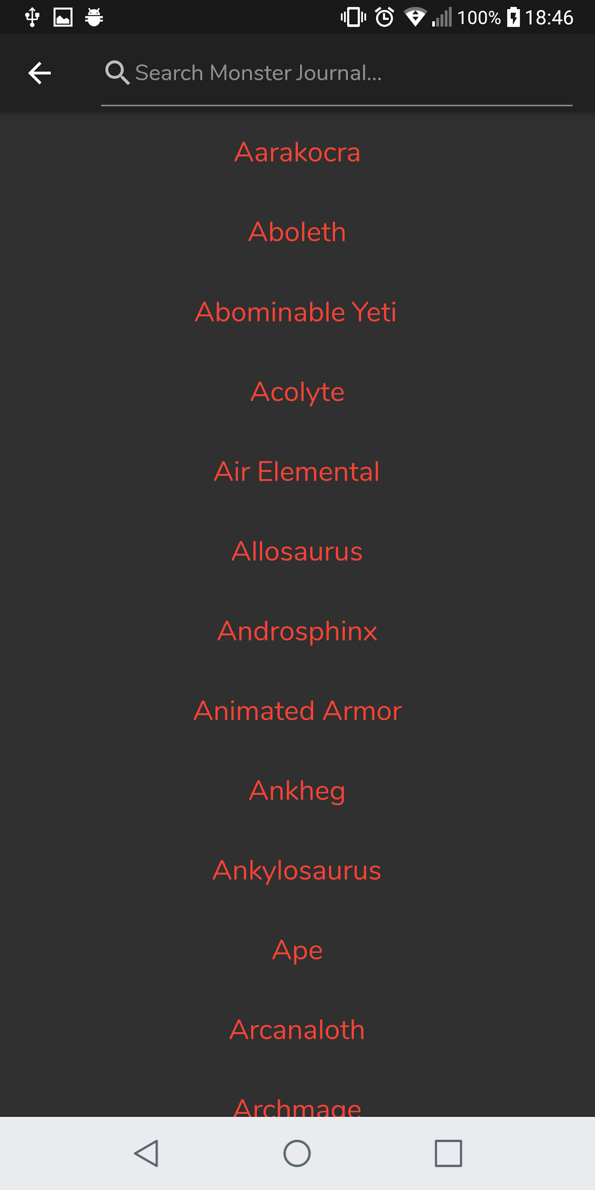
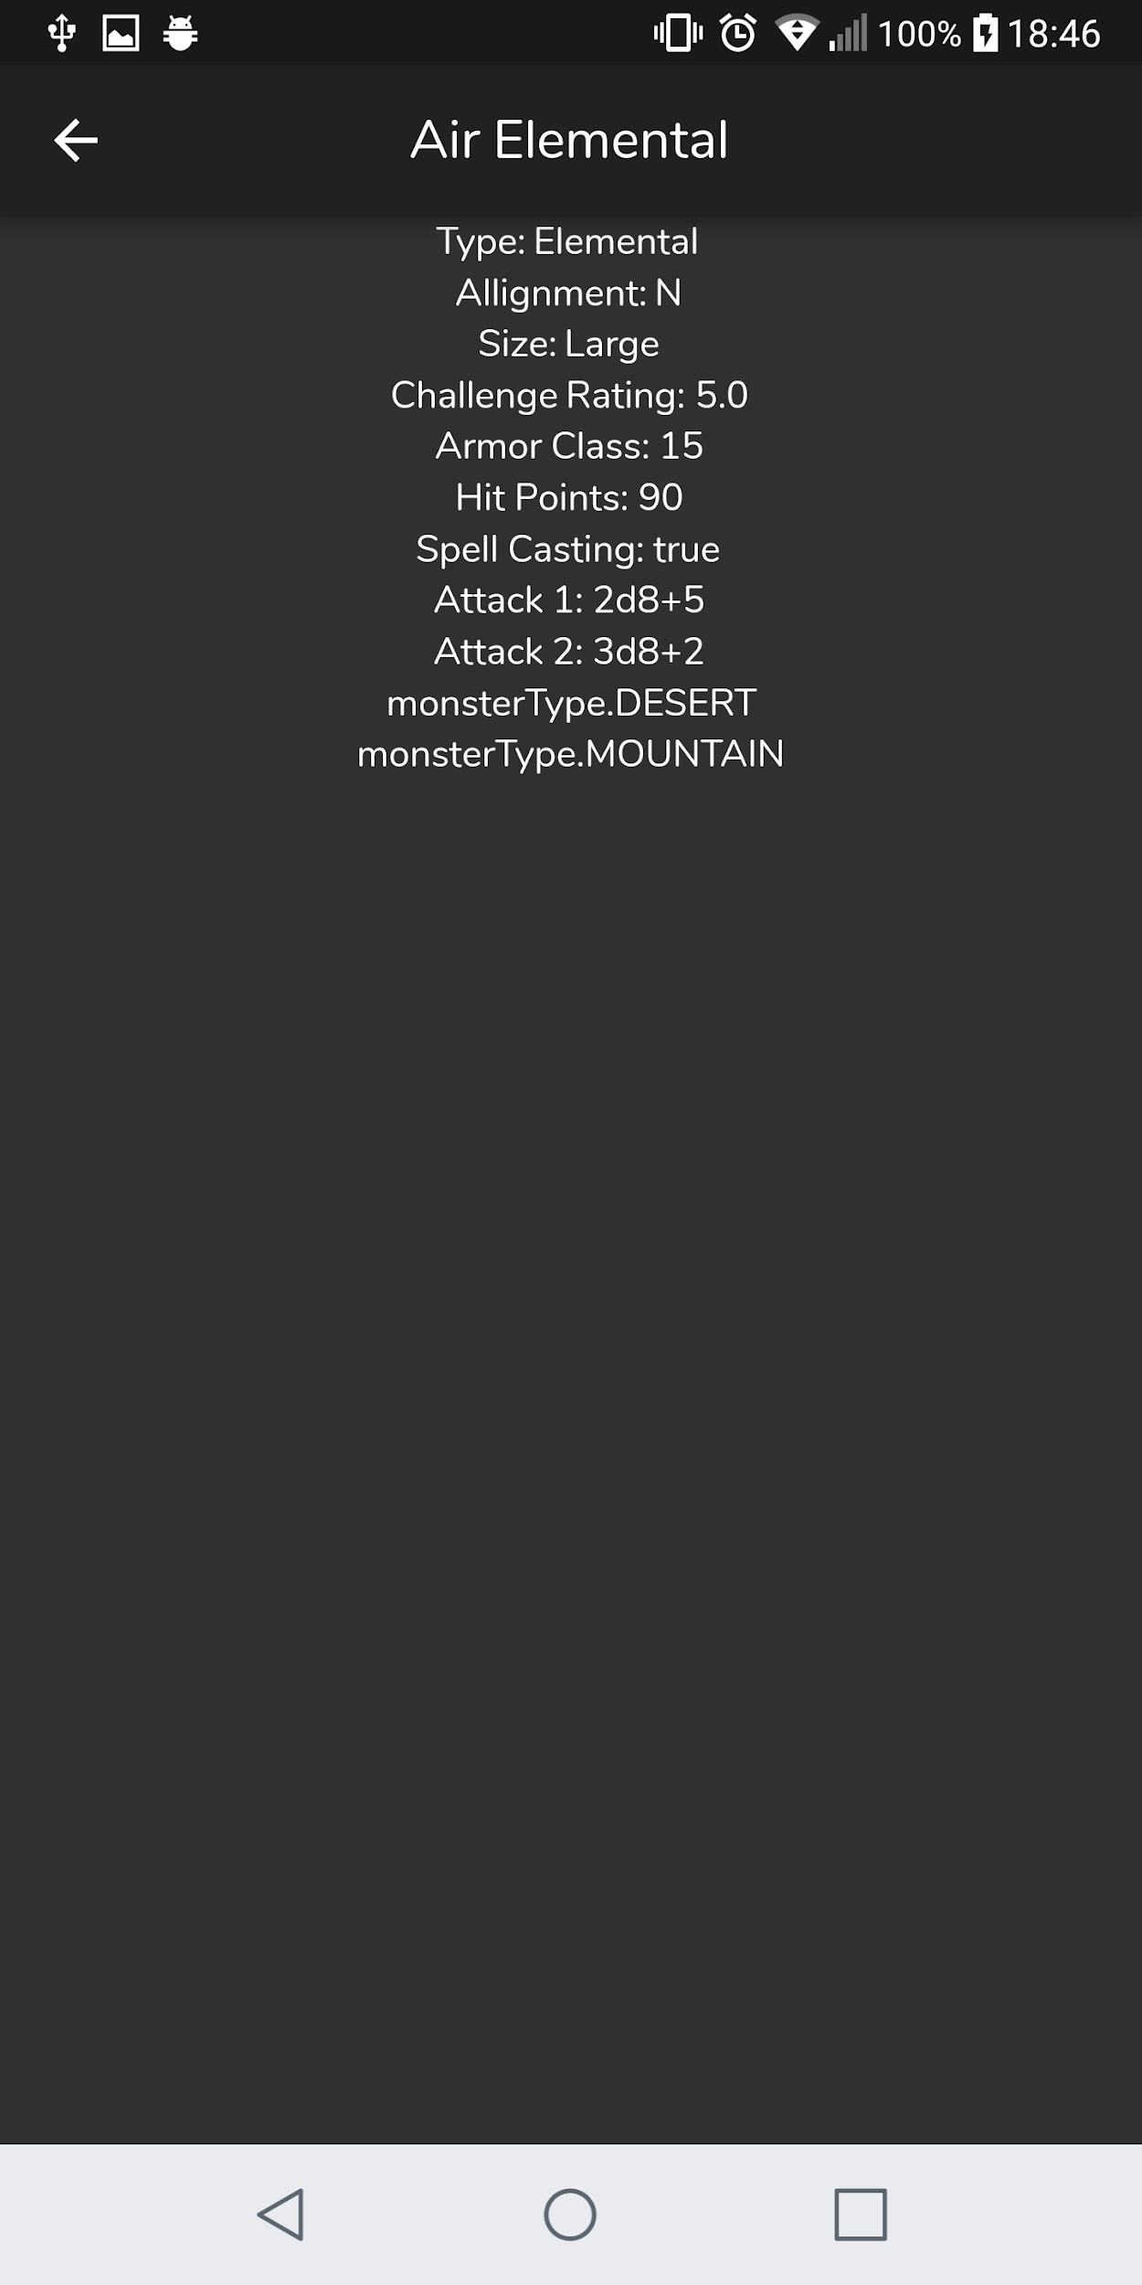

Slide 10
Using the system:
When a user wants to create a character, they will be taken to a character creation screen, where they can create a character by specifying a name for his character, choose a race, choose a gender, and choose a class. They are also able to specify the values for the 6 main stats of a main character, as well as things like the characters equipment, and additional flavour text such as traits, flaws, alignment, etc.
Once a user has created a character, they will appear in the character selection screen. Here they can either click on the character to get a detailed description of the character and their stats, or they can simply swipe from left to right over a character to bring up a small window which will show the character stats.

Slide 11
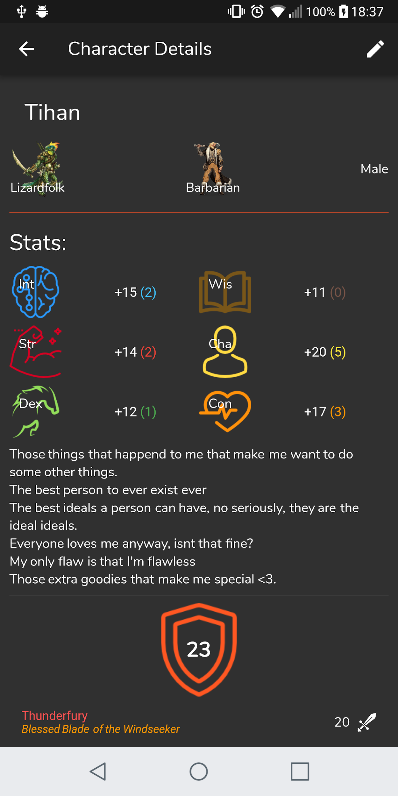
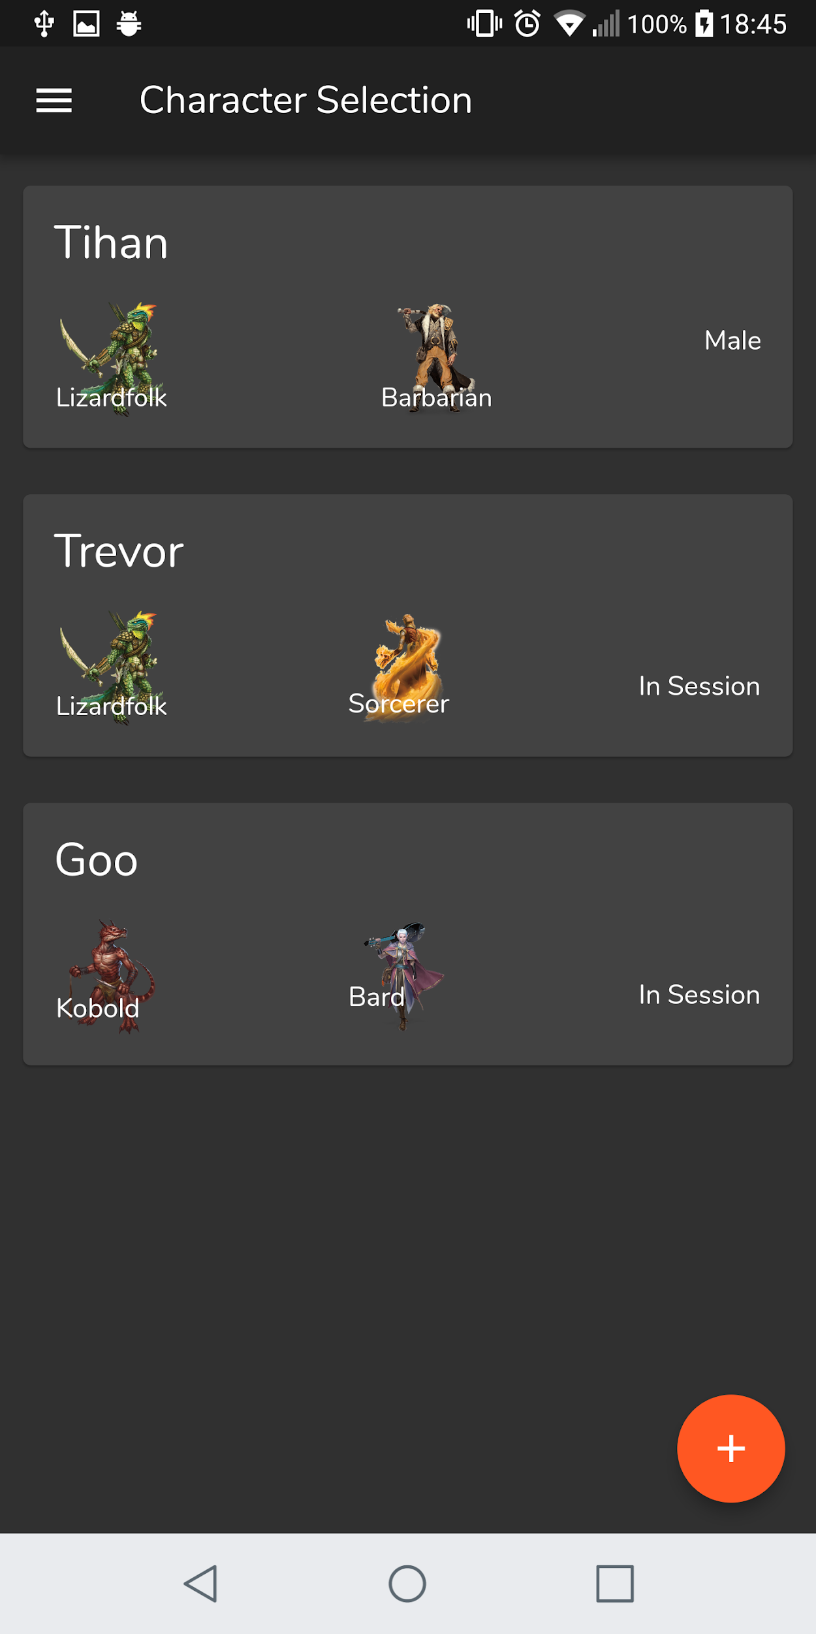

Slide 12
Using the system:
On the homepage, you will see two buttons: Join Session and Create Session. If you wish to create a session, you will take the role of the Dungeon Master automatically. The button will start the session creation process. Once a session has been created, a QR code will be generated on the Dungeon Master’s device.
All players that are taking on the role of a normal adventurer, will then click Join Session, which will automatically open up their camera. All the user then has to do is scan the QR code generated by the Dungeon Master, and they will be taken to a screen which shows the session name, the host of the session (a.k.a. The Dungeon Master), and a list of all the other players currently in the session.
Once all players have joined the session, the Dungeon Master will click “Enter Session” where he will be taken to the same screen as the other users, and from here he will officially start the game session. (See the next slide for screenshots)

Slide 13
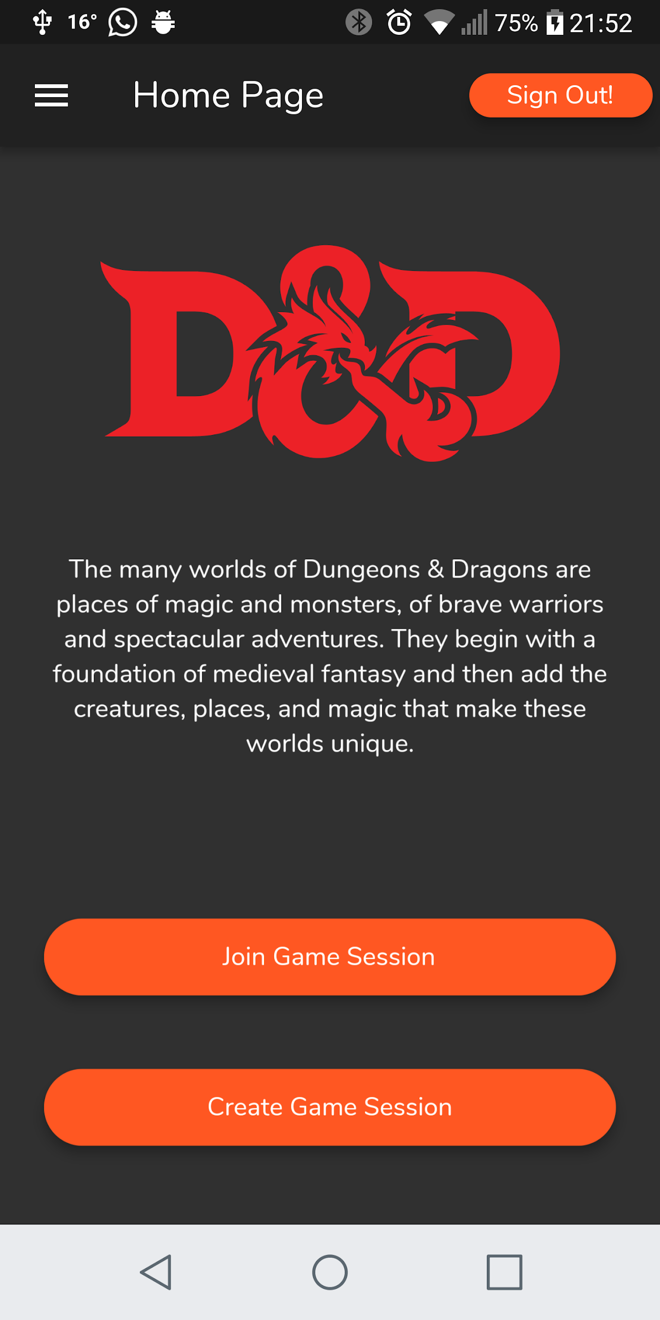
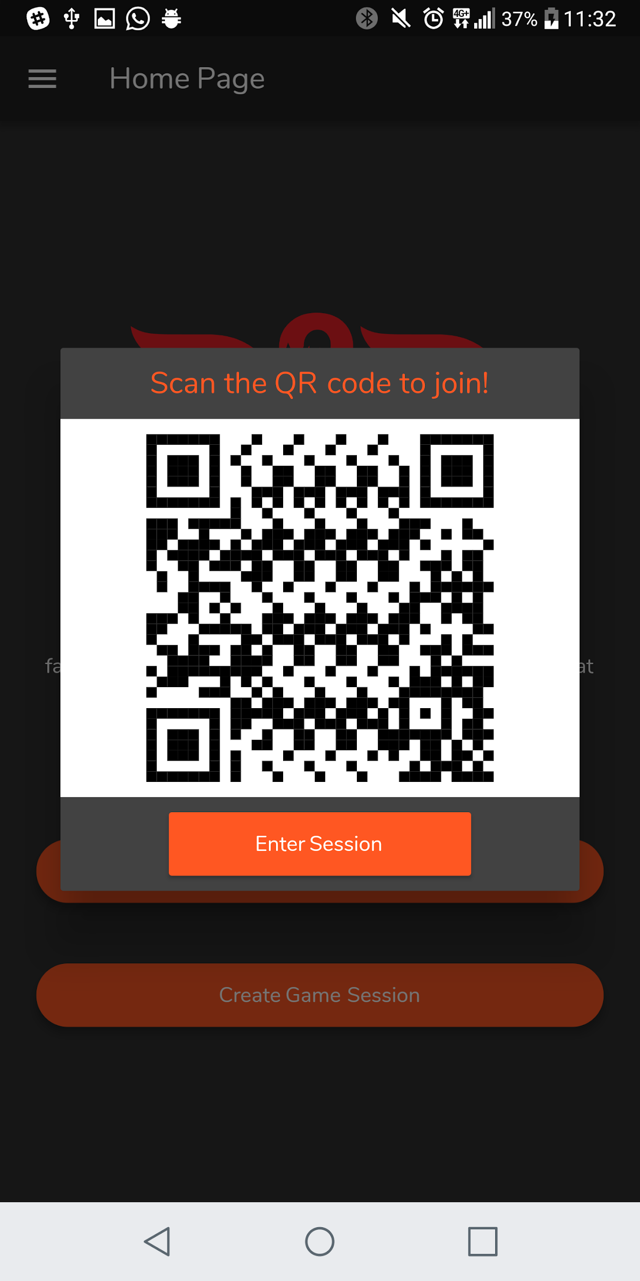
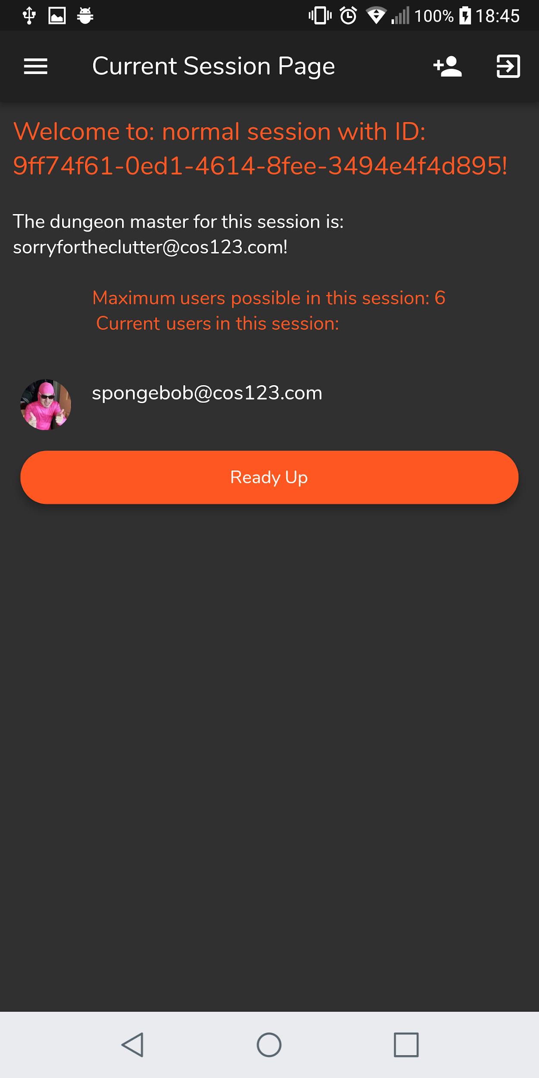

Slide 14
Using the system:
As a dungeon master, a user will be able to see all the characters in the current session as well as who the character belongs to. The dungeon master will also be able to add monsters to the session. He is able to assign a combat rating to the monster, as well as how much experience will be granted when it is killed. He also has the ability to “kill” monsters, which will them remove them from the session, and the experience will be distributed accordingly to the players in the party.
As a normal user (referred to as an adventurer in this user manual), you will be able to see all your current characters in the session, as well as a screen where you can view the other users in your party (excluding the dungeon master). An adventurer will either be able to “upload” an existing character into the session, or create a new character in the session itself and then add that character to his currently active characters

Slide 15
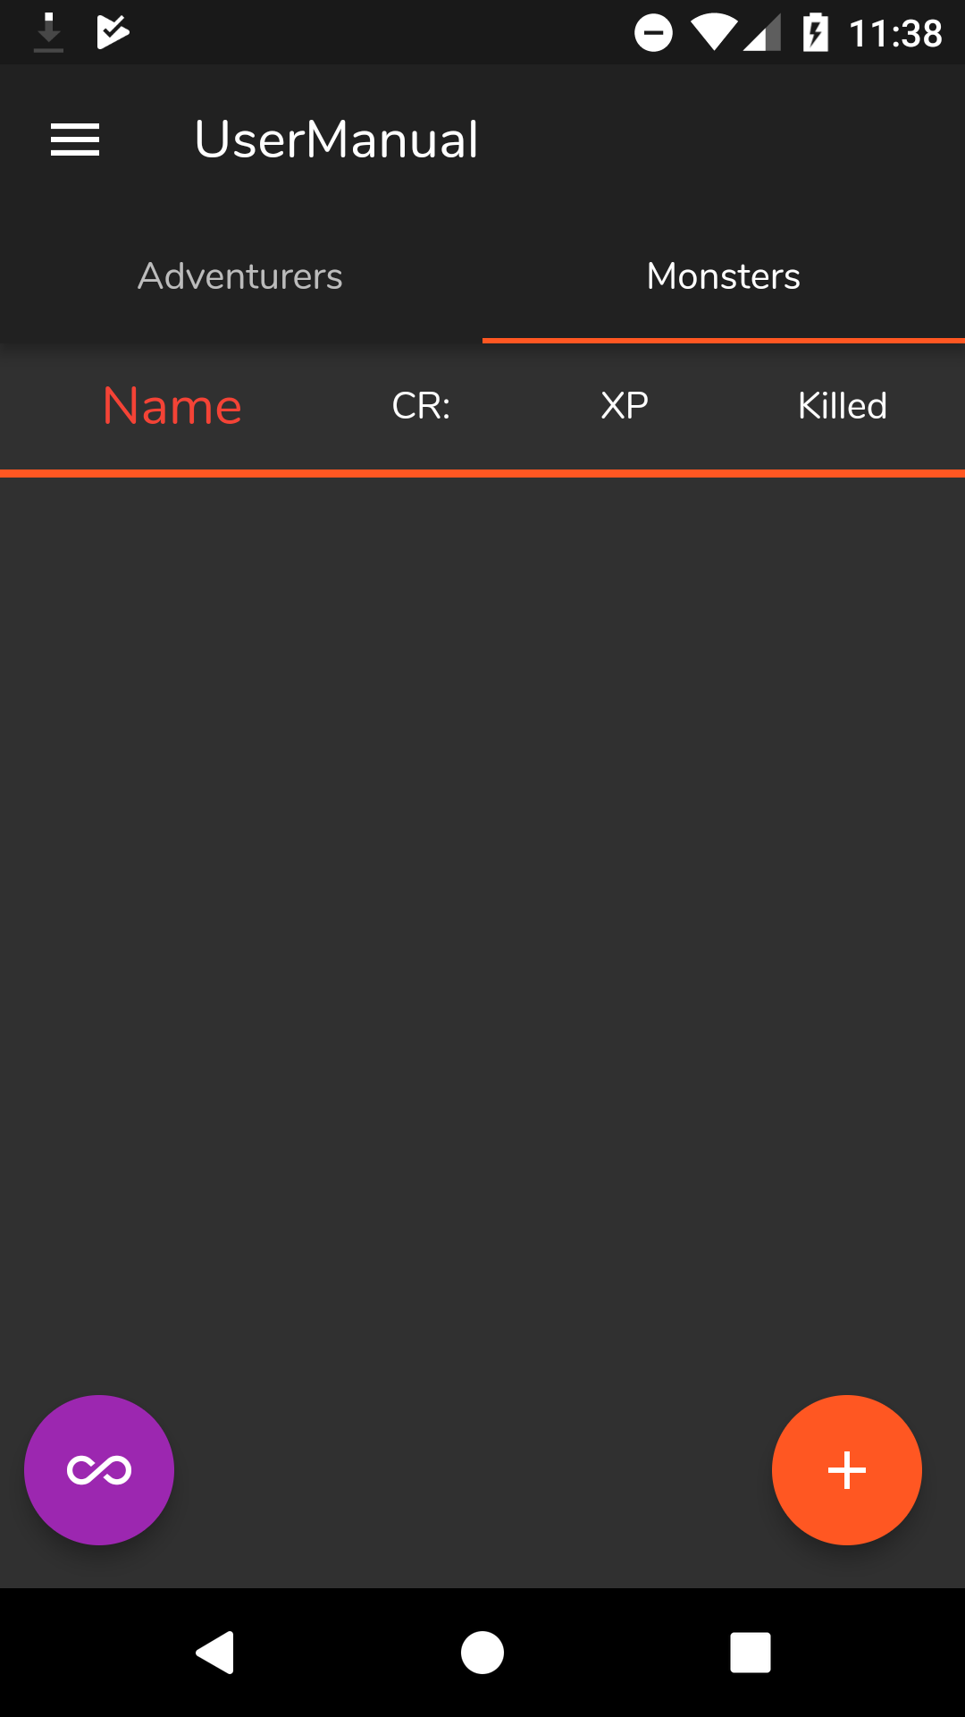
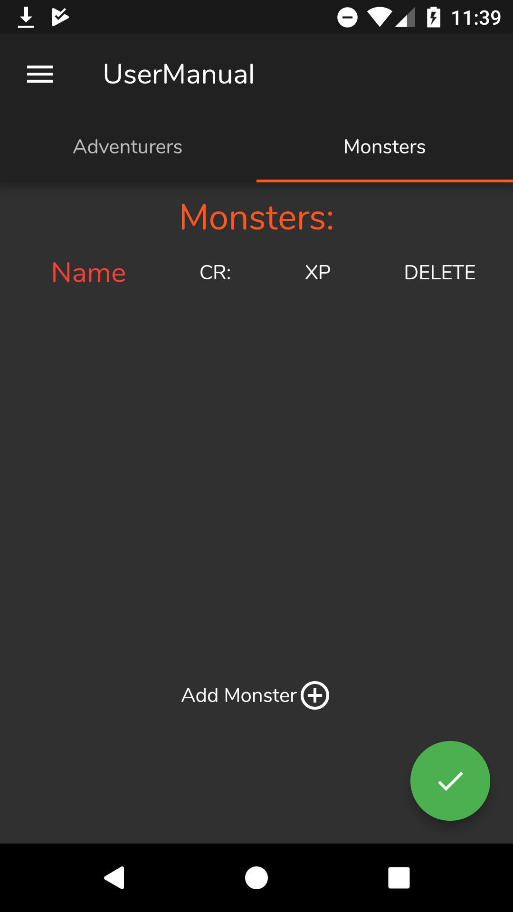
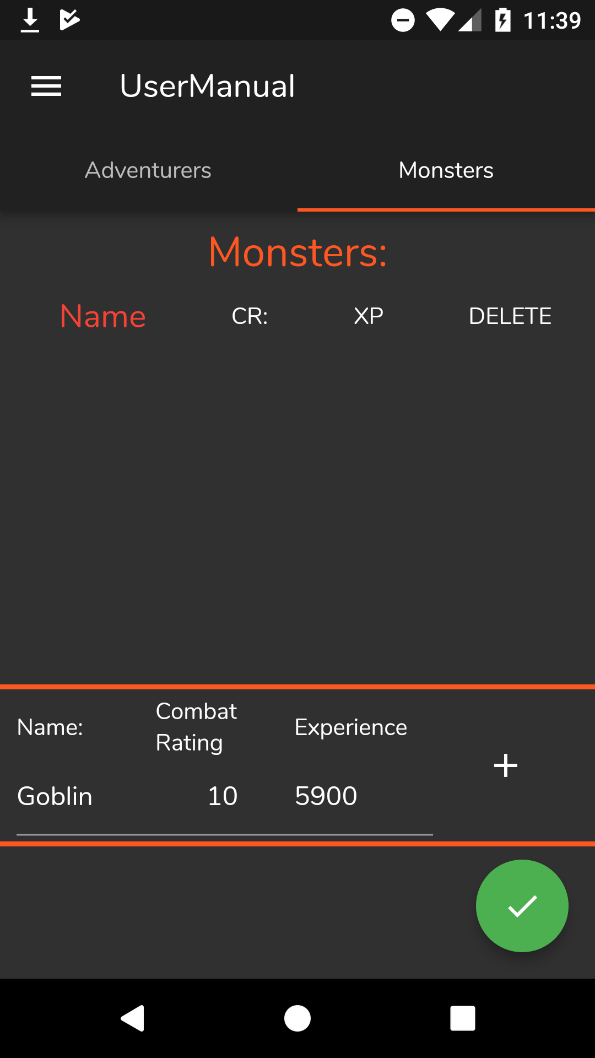
Using the system:
To add a monster, press the + button in the right hand corner. You will then need to press the Add Monster button in the middle of the screen. Fill in the required details, then press the + button next to the experience tab. Once you are done adding all monsters, press the button on the bottom right hand corner again

Slide 16
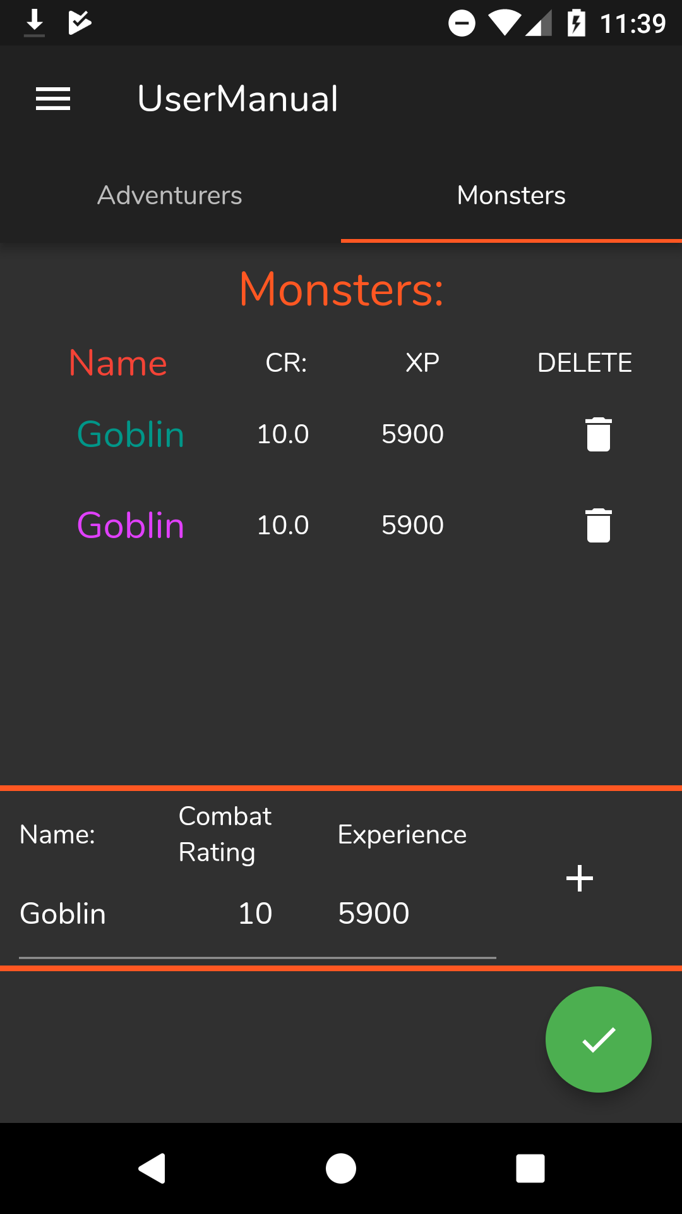
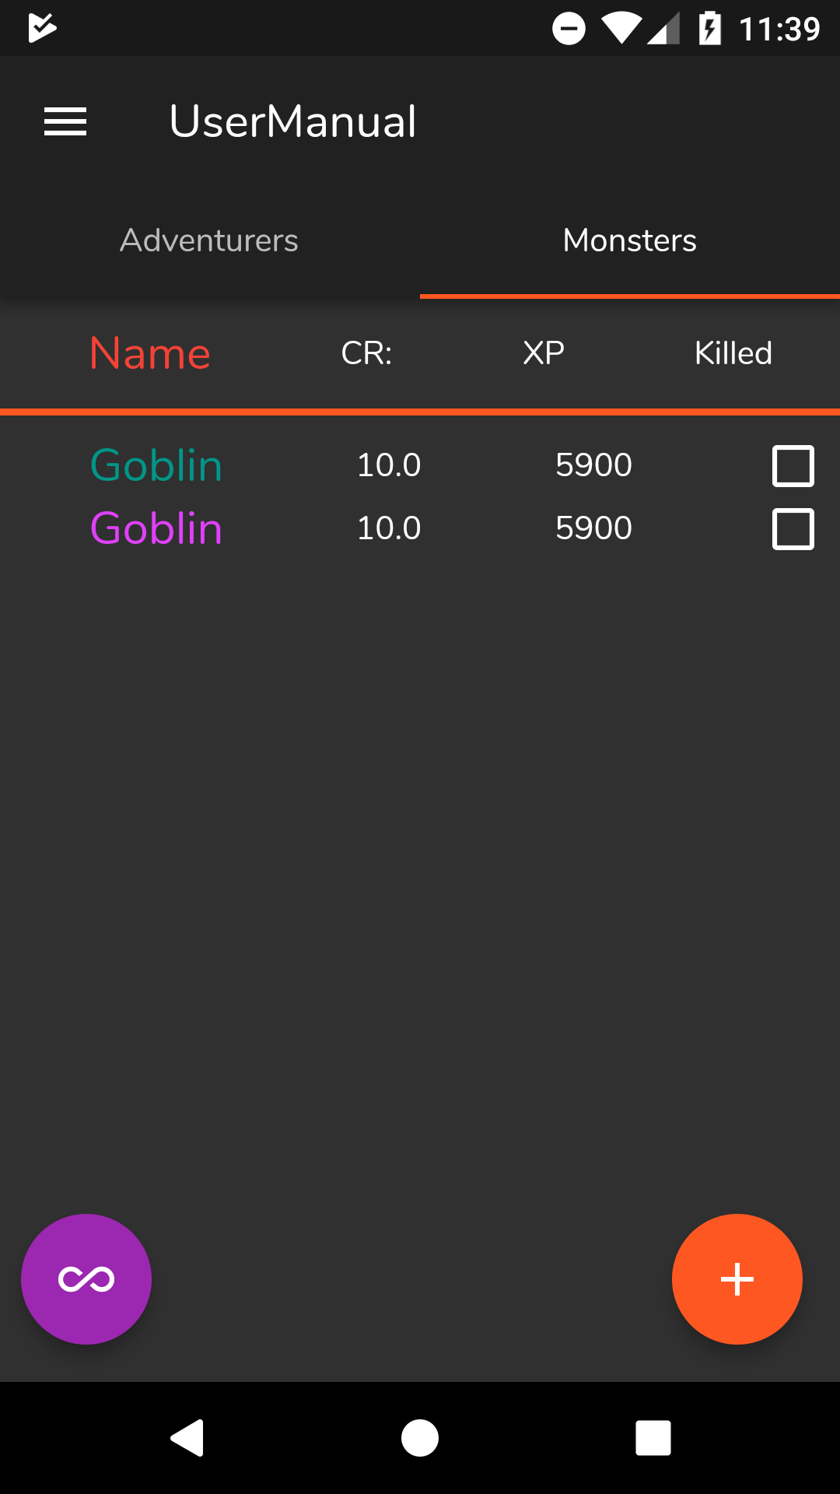
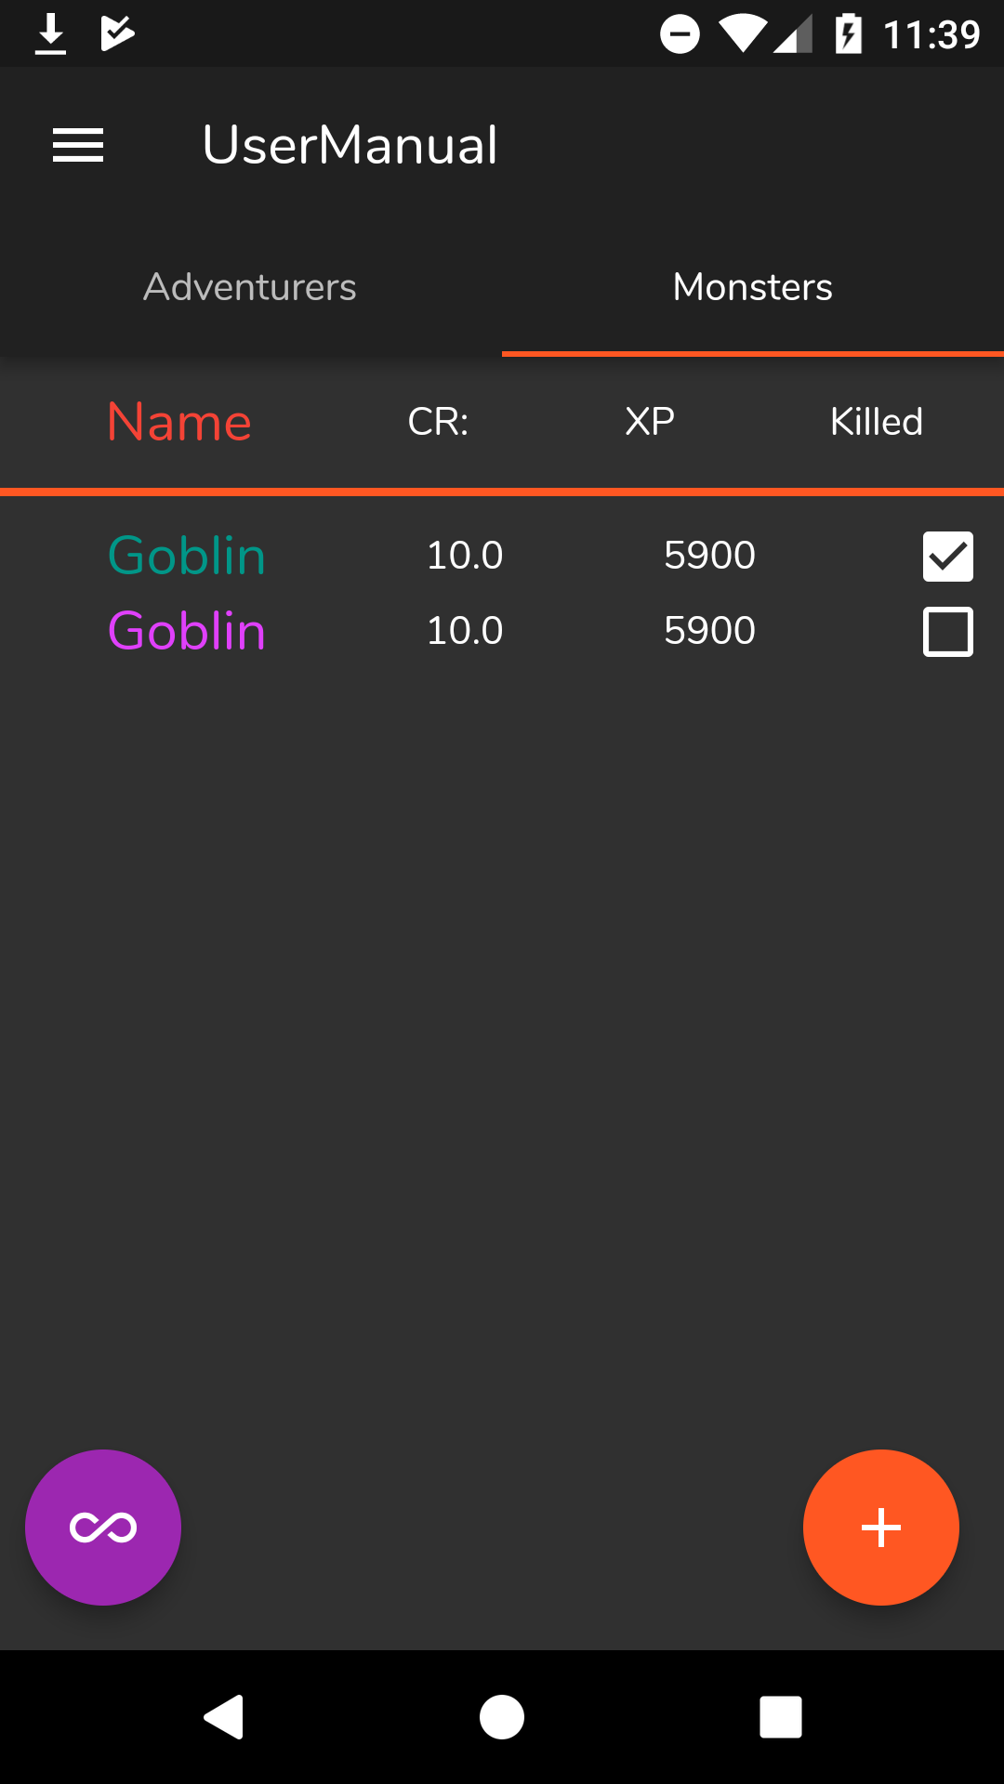
Using the system:
Simply tick the monster which you wish to kill, and then press the button on the bottom left hand corner to complete the action. In this example, the Goblin with the green name will be removed from the list afterwards

Slide 17
Troubleshooting:
If you choose to sign in with a Google Account for the first time, and then proceed to sign out, and wish to sign in with Google again later, it will automatically sign you in with the new Google Account that you used in the previous sign in process. If this happens, stop the application completely, and reopen it. When you now choose Google Sign in, it will bring the pop up box into view, showing all Google Accounts you have used before. When you sign out now and proceed to sign in again, it will follow the correct process of first asking which account you would like to use.

